Slide 1
Self-Regulation: An individualized Journey
Elizabeth (Liz) Delsandro, MS., CCC-SLP
Autism Society of Iowa Fall Conference
November 5, 2021
https://www.freepik.com/vectors/background

Slide 2
objectives
To explore strategies for self-regulation.
To consider tenets of trauma-informed care when working on self-regulation.
To recognize the importance of collaboration /teaming when developing an individualized plan for self-regulation.
To identify environmental considerations/structure that can promote regulation of emotions

Slide 3
Anxiety
Anxiety is identified as the most commonly reported disorder among individuals with Autism Spectrum Disorders (Hollocks, Lehr, Magiati, Meiser,-Stedman, & Brugha 2018; Rodgers & Ofield, 2018)
Researchers suggest that up to 70% of adults with autism spectrum disorders are diagnosed with anxiety disorders (Lugo-Marin, 2019).

Slide 4
Uncertainty Intolerance
In a study conducted by Saiz-Suanes et al (2020), anxiety correlated with variables of emotional dysregulation and uncertainty intolerance. They also shared that adults with autism and intellectual disability showed greater of maladaptive emotional regulation strategies and uncertainty intolerance.

Slide 5
Emotional Regulation
When people try to manage and understand emotions and adapt their emotional response to the context or situation, it is referred to as emotional regulation (Gross, 2015).

Slide 6
Beneath the surface
Dysregulation in a
Individual
Limited or restless sleep
Unmet needs
Constipation
Allergies/reactions
Negative emotions
Eating/feeding differences
Significant transition/changes
Limited quality relationships
Sensory differences
Communication differences

Slide 7
Beneath the surface
Trauma
“Research indicates that youth living with
intellectual and developmental disability
(IDD) experience exposure to trauma at
a higher rate than their non-disabled peers.”
-The National Child Traumatic Stress Network

Slide 8
Flight-Fight-Freeze
Please note that this is not a complete list of behaviors. Additionally, these are examples
of what you may see in an individual without neurodevelopmental disabilities.
Flight | Fight | Freeze
Withdrawing Fleeing the situation/room Daydreaming Seeming to sleep Avoiding others Hiding or wandering Becoming disengaged | Acting out Behaving aggressively Acting silly Exhibiting distance Being hyperactive Arguing Screaming/yelling | Exhibiting numbness Refusing to answer Refusing to get needs met Feeling unable to move or act
(Souers & Hall, 2016)

Slide 9
Beneath the Surface
Regulation in a
Individual
Well rested
Nutritional needs met
Met needs
Digestive health in check
Allergies managed
Positive emotions
Medications managed
Safe people and safe spaces
Sensory experiences balanced
Established and familiar routines
Developing way to communicate

Slide 10
Highlighting Some of Maslow’s Hierarchy of Needs
Self-actualization
The desire to become the most that one can be
Esteem
Self-esteem, respect, recognition, freedom
Love and Belonging
Family and sense of connection
Safety Needs
Health and wellness
Physiological Needs
Shelter, food, sleep

Slide 11
Questions to Ask Related to Maslow’s Heirarchy of Needs
Questions for
caregivers and
program personnel
to discuss
Is the individual getting sleep?
Is the individual eating well?
Is the individual healthy?
Is the individual feeling supported by the people around him/her/them?
Does the individual have a safe space to process his/her/their emotions?
Are there supports/strategies in place?
Does the individual have an opportunity make choices?
Does the individual have a mean to communicate his/her/their emotions in an adaptive manner?
Questions for
program personnel
to consider

Slide 12
Communication is key!
Communication Notebook or 2-Minute Check-in:
What you check-in about (e.g., sleep, overall health,
change) is really dependent on the individual.
What you find out may direct you to
DIAL IT UP or DIAL IT DOWN.
MIN
MAX

Slide 13
Basic Considerations

Slide 14
Communication with Caregivers
If a individual has known behavior challenges, collaborate with the individual’s parents/caregivers:
Parents/caregivers are experts in their child.
Find out what strategies work to promote the individual’s adaptive behavior.
Parents/caregivers are often quite knowledgeable in what is motivating or reinforcing to the individual.
Parents/caregivers can keep you updated on what is happening in the lives of the individual.

Slide 15
Be Encouraging and Supportive
Individuals, regardless of their level of functioning, recognize if you enjoy them.
Take time to establish rapport with the individual. This is an ongoing process. Relationship matters.
Observe and listen to the individual.
Respond to your individual.
Use a positive tone of voice.
Provide verbal praise and encouragement.

Slide 16
Linguistic Level
Communicate with the individual as the his/her/their linguistic level.
Use vocabulary that is appropriate for the individual’s chronological age and developmental functioning.
If the individual is visibly frustrated, reduce the amount of language you are using with the individual:
Less talking = less frustration
Incorporate more pauses.
Processing language can be challenging when an individual is frustrated.

Slide 17
Uncertainty Intolerance
Buhr and Dugas (2009) defined uncertainty intolerance as a dispositional characteristic that results from a set of negative beliefs about uncertainty and its implications and involves the tendency to react negatively on an emotional, cognitive, and behavioral level to uncertain situations and events.”

Slide 18
Present Clear Expectations
Clear expectations can reduce potential anxiety.
Establish some routines.
Provide a visual schedule. A schedule answers a variety of questions:
What will I be doing?
What’s next?
When do I get to do _____?
When will I be finished?

Slide 19
Present Clear Expectations
Ensure that instructions are considerate of a individual’s linguistic level:
Level of vocabulary
Length of instructions (e.g., 1-part instructions, 2-part instructions)
Provide models of expected behavior or what the individual should be doing before asking the client to carry out the behavior or task.
Model
Role-play what the expected behavior looks like.
Video model of what the expected behavior looks like.

Slide 20
Intersperse Easier Tasks into the Session
Embed opportunities for the individual to be successful by incorporating some easier tasks.
Consider the order of the “easy” tasks and “challenging” tasks for the individual.

Slide 21
Intersperse Motivating Activities into the Day
Always be aware of what activities/objects/topics motivate the individual.
Always be “in the know” with what reinforces the individual (keep informed by asking the individual, connecting with parents/caregivers).
Strategically place motivating activities into the day.
Integrate motivating topics/activities into the day.
Alternate motivating activities with less motivating activities in individual’ schedule.
Consider first-then language (e.g., First, _________. Then, we can ________.”)

Slide 22
Consider Sensory Needs of the individual
Some individuals need to move to regulate themselves in order to attend and participate in planned therapy activities.
Plan movement into activities.
Change physical positions (e.g., work at the table, on the floor, at the board).
Consider movement breaks (e.g., mini dance party).
Consult with an occupational therapist if possible about building in sensory activities or creating a sensory diet.

Slide 23
Again: relationship Matters!
Helpful hints for establishing relationships:
Be open, positive, flexible, and understanding.
Establish positive routines. Routines can be comforting.
Provide the “just right” level of support, so the individual can be successful in activities.
Recognize the individual’s strengths and incorporate opportunities in the individual’s day to showcase his/her/their strengths.
Recognize the individual’s interests and motivators, and incorporate opportunities for the individual to engage in their interests within the day.
Become knowledgeable of what triggers emotions such as discomfort, fear/anxiety, sadness, and anger in the individual. And, avoid these triggers if possible.
Create a safe space for an individual to experience his/her/their emotions.

Slide 24
The failure to imagine how the world is Experienced by Autistic people creates a faulty attribution of inappropriate Emotionality. -Bervoets et al (2021)

Slide 25
Interoceptive awareness
“Emotion regulation involves a coherent relationship with the self, specifically effective communication between body, mind, and feelings. Effective emotion regulation involves the ability to accurately detect and evaluate cues related to physiological reactions to stressful events, accompanied by appropriate regulation strategies that temper and influence the emotional response. There is compelling evidence demonstrating links between poor or disrupted awareness of sensory information, or interoceptive awareness, and difficulties with emotion regulation.” (Price & Hooven, 2018)

Slide 26
Systems for Emotional Regulation
The Incredible 5-Point Scale
https://www.5pointscale.com/
The Zones of Regulation
https://zonesofregulation.com/index.html
Interoception: The Eighth Sensory System
https://www.kelly-mahler.com/

Slide 27
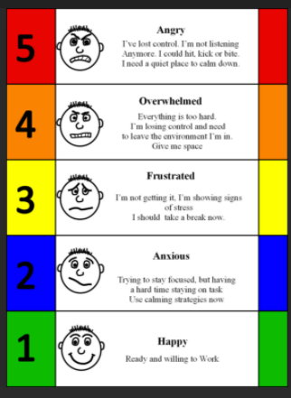
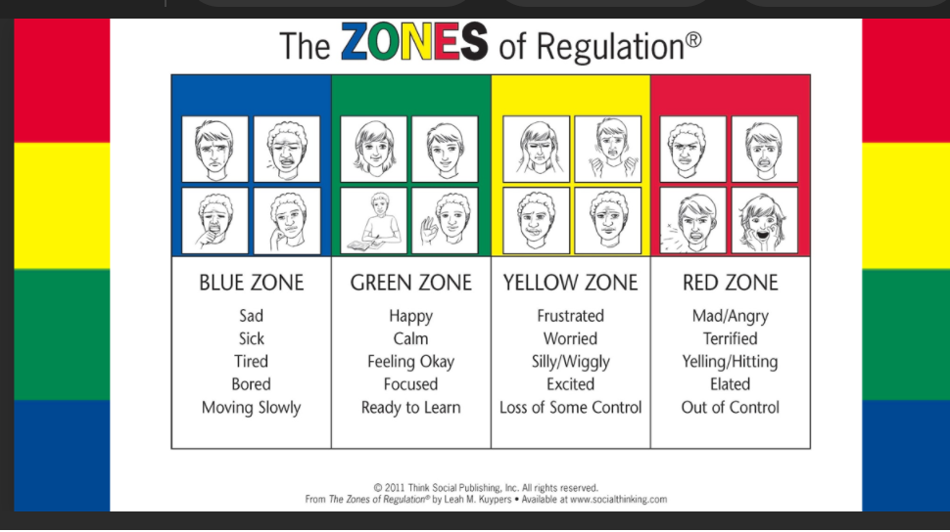
ADOpting a System
Examples:
The Zones of Regulation
Leah Kruypers
The Incredible 5-Point Scale
Kari Dunn Buron & Mitzi Curtis

Slide 28
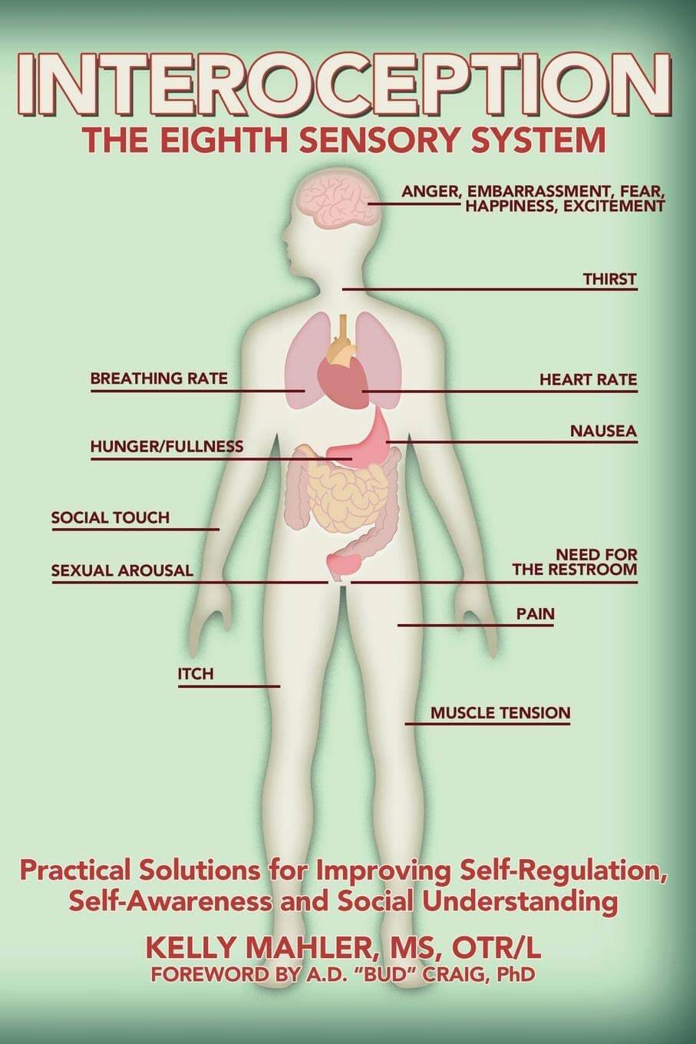
ADOpting a System
Interoception: The Eighth Sensory System
Kelly Mahler, MS, OTR/L

Slide 29
References
Bervoets, J., Milton, D., & Van de Cruys, S (2021). Autism and intolerance of uncertainty: an ill-fitting pair. Trend in Cognitive Sciences. In press.
Buhr, K. & Dugas, M. J. (2009). The role of fear of anxiety and intolerance of uncertainty: An experimental manipulation. Behaviour Research and Therapy, 47, 215-223.
Gross, J. (2015). The extended process model of emotion regulation: Elaborations, applications, and future directions. Psychological Inquiry, 26, 130-137.
Hollocks, M., J., Lehr, J.W., Magiati, Meiser,-Stedman, I., & Brugha, T. S. (2018). Anxiety and depression in adults with autism: A systematic review and meta-analysis. Psychological Medicine, 1-14.

Slide 30
References
Lugo-Marin, J., Magan-Maganto, M., River-Santana, A., Cuellar-Pompa, L., Alviani, M., Jenaro-Rio, C. et al (2019). Prevalence of psychiatric disorders in adults with autism spectrum disorder: A systematic review and meta-analysis. Research in Autism Spectrum Disorders., 59, 22-33.
Price, C.J. & Hooven, C. (2018). Interoceptive awareness skills for emotion regulation: Theory and approach of mindful awareness in body-oriented therapy (MABT). Frontiers in Psychology, 9, 1-12.
Saez-Suanes, G.P., , Garcia-Villamisar, , D., del Pozo Armentia, Araceli, & Dattilo, J. (2020). Emotional dysregulation and uncertainty intolerance as transdiagnostic mediators of anxiety in adults with autism spectrum disorders and intellectual disability, Research in Developmental Disabilities,106, 1-11.
Souers, K. & Hall, P. (2016). Fostering resilient learner: Strategies for creating trauma-sensitive classroom. Alexandria, VA: ASCD.
Rodgers, J. & Ofield, A. (2018). Understanding, recognizing and treating co-occurring anxiety in autism. Current Developmental Disorders Reports, 5, 58-64.

